Slide 1
Javascript 101
The functional side of Front-End

Slide 2
Characteristics
" and ' can be used in pairs
Scope rules for variables
Strings are very common data types
Rich set of methods available
Arrays have dynamic length
Array elements have dynamic type
Arrays are passed by reference
Array elements are passed by value

Slide 3
And more…
Division with / is not integer division
Modulus (%) is not an integer operator
5 / 2 yields 2.5
5.1 / 2.1 yields 2.4285714285714284
5 % 2 yields 1
5.1 % 2.1 yields 0.8999999999999995

Slide 4
Hello World
window.alert( "Welcome to JavaScript Programming!" );

Slide 5
Equivalent of System.out.println()
Console.log()

Slide 6
Your new console
Is the browser console

Slide 7
modules
Jquery
NodeJS
AngularJS
…

Slide 8
File structure
Filename.js

Slide 9
Include in jsp/html
<script type="text/javascript" src="js/plugins/jquery/jquery.min.js"></script>

Slide 10
Window.onload
We cannot use the DOM before the page has been constructed. jQuery gives us a more compatibile way to do this.
The DOM way
The direct jQuery translation
The jQuery way
window.onload = function() { // do stuff with the DOM }
$(document).ready(function() { // do stuff with the DOM });
$(function() { // do stuff with the DOM });

Slide 11
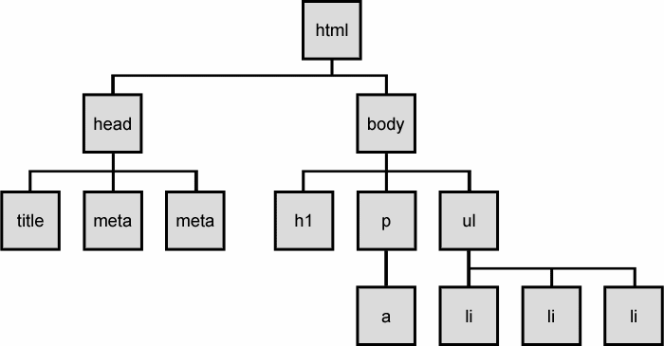
The DOM Tree

Slide 12
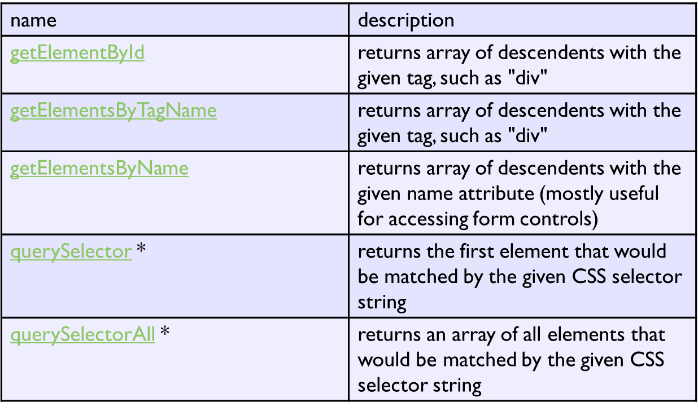

Slide 13
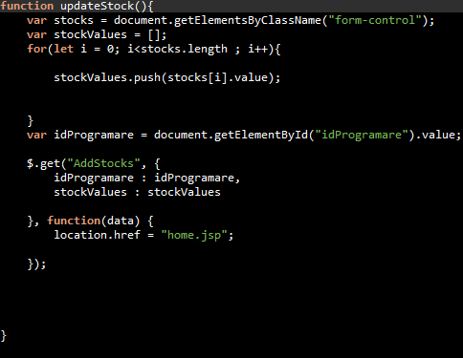

Slide 15
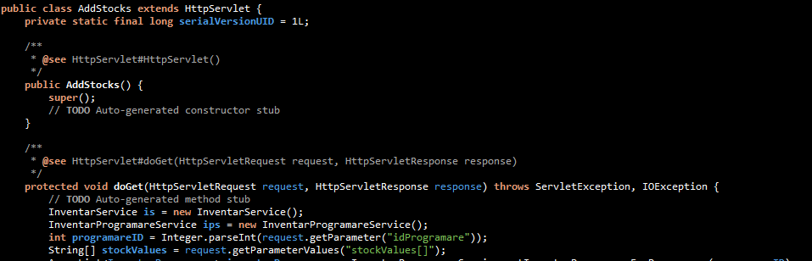

Slide 16
Binding js to button clicks
<button type=“submit” onClick=“function();” value=“Apasa-ma”/>
<input type=“submit” onClick=“function2();” value=“Apasa-ma”/>

Slide 17
Javascript validations
function validateForm() { var x = document.forms["myForm"]["fname"].value; if (x == null || x == "") { alert("Name must be filled out"); return false; } }

Slide 18
Javascript validation
<form name="myForm" action=“MyServlet" onsubmit="return validateForm()" method="post"> Name: <input type="text" name="fname"> <input type="submit" value="Submit"> </form>

Slide 19
Javascript String functions
var txt = "ABCDEFGHIJKLMNOPQRSTUVWXYZ"; var sln = txt.length;

Slide 20
Javascript String functions
var str = "Please locate where 'locate' occurs!"; var pos = str.indexOf("locate");

Slide 21
Javascript String functions
var str = "Please locate where 'locate' occurs!"; var pos = str.lastIndexOf("locate");

Slide 22
Javascript String functions
var str = "Apple, Banana, Kiwi"; var res = str.slice(7,13);
var res2 = str.slice(7);

Slide 23
Javascript String functions
str = "Please visit Microsoft!"; var n = str.replace("Microsoft",“Enered");

Slide 24
Javascript String functions
var text1 = "Hello World!";
var text2 = text1.toUpperCase();

Slide 25
Javascript String functions
var text1 = "Hello World!";
var text2 = text1.toLowerCase();

Slide 26
Javascript String functions
var text1 = "Hello"; var text2 = "World"; var text3 = text1.concat(" ",text2);

Slide 27
Javascript String functions
var txt = "a,b,c,d,e";
txt.split(",");

Slide 28
Exercise 1
Build a webpage with 2 inputs and required validation on submit

Slide 29
Exercise 2
Add 1 input with length validation

Slide 30
Exercise 3
Create a paragraph that is only shown after submit, if the user entered “OK” in the first input and he clicks the submit button and hide it otherwise

Slide 31
Exercise 4
Create a paragraph that displays the perimeter of a triangle with the lengths entered in the previously created input fields after user clicks on a button.

Slide 32
Exercise 5
Create a paragraph that displays the perimeter of a triangle with the lengths entered in the previously created input fields after user clicks on a button.

Slide 33
Exercise 6
Write a JavaScript program to convert temperatures to and from celsius, fahrenheit.
Formula : c/5 = (f-32)/9 [ where c = temperature in celsius and f = temperature in Fahrenheit ]

